Slide 1
Using E- Assessement Structured Communication Grid Test (SCGT) to Assess High Levels of Thinking Skills
By
Associate Professor Samir Najdi
And
Assistant professor Randa El Sheikh

Slide 2
E-assessments
Advantages over traditional (paper-based) assessments:
Broaden the range of assessed skills.
Provide students with more timely and informative feedback on their progress.
Quicke, cheape, and efficient.

Slide 3
1- Classical Electronic Assessments
True – false tests.
Multiple choice tests / one answer .
Multiple choice tests / more than one answer.

Slide 4
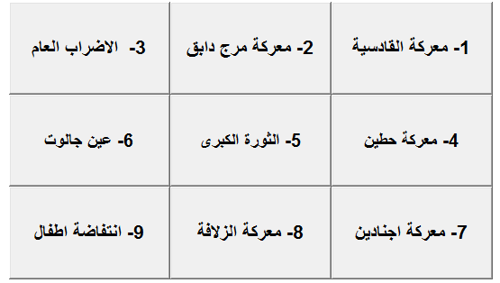
2- Structured Communication Grid Test.

Slide 5
Questions types
Regular questions
The order of selection the correct boxes is not important.
Ordered questions
The order of selection the correct boxes is important.

Slide 6
SCGT studies revealed that:
SCGT diagnose misconceptions and erroneous information learners hold.
Can measure meaningful learning.
SCGT can positively affect the achievements of learners , and increase their working memory capacity.
Significance of this study
Can be used to promote deeper and more effective learning, by testing higher levels of thinking skills

Slide 7
Questions of the study
What is the correlation between TFT and SCGT?
Can SCGT assess higher levels of thinking skills?
Is it possible to demonstrate a computer-based SCGT technique?

Slide 8
Data collection and analysis
A random Sample of 121 QOU math learners completed both SCGT and TFT.

Slide 9
Table2: Descriptive statistics of TFT and SCGT of section 2
Table1: Descriptive statistics for TFT and SCGT of Section 1
Spearman's rho between TFT and SCGT =0.903 (significant at 0.05 level)
St.Err | S.D | Mean | Max | Min | N | Test
1.71 | 18.3 | 71.25 | 100 | 40 | 112 | TFT
1.7 | 18.0 | 71.56 | 100 | 35 | 112 | SCGT
Cronbach | St Error | S.D | Mean | Max | Min | N | Test
0.83 | 2.0 | 21.2 | 63.8 | 100 | 40 | 121 | TFT
0.84 | 1.94 | 20.5 | 66.2 | 100 | 35 | 121 | SCGT

Slide 10
Results
Tables 1 and 2 show that the means of TFT and SCGT in the first section are almost similar, where as in the second section the mean of SCGT is higer than the mean of TFT.
The tables also show that the results of the correlation between TFT and SCGT in both sections are positively high
-as expected- because both assessments are objective and are testing the same narrow area of understanding.

Slide 11
To answer the second question of the study
Can SCGT assess higher levels of thinking skills?
T-test for dependant samples was conducted on the data.

Slide 12
Means of TFT and SCGT for Section 1
Table 3: Paired Samples t-test
 |  | Paired Differences |  |  |  |  | t | Df | Sig. (2-tailed)
Section | 1 | Mean | Std. Deviation | Std. Error Mean | 95% Confidence Interval of the Difference
 |  |  |  |  | Lower | Upper
Pair 1 | TFT – SCDT | .31250 | 9.28821 | .87765 | -1.42663 | 2.05163 | .356 | 111 | .722

Slide 13
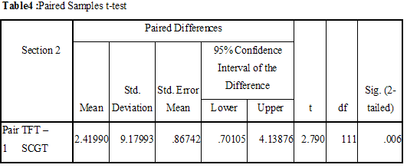
Means of TFT and SCGT for Section 2

Slide 14
Results
These results indicate that there is no significant difference between the mean of TFT and SCGT where (t =0.356, p = 0.722).
These results indicate that the mean of SCGT is significantly higher than the mean of TFT ( 66.25 and 63.83 respectively) where (t =2.7, p = 0.006).

Slide 15
Qualitative Results.
50 learners were interviewed in order to probe their views about SCGT technique
An open-ended question was addressed to the learners: ”Give your opinion of SCGT technique”

Slide 16
Students Reflections
This technique made them contemplate, analyze, originate, integrate, and combine information into full answers which in turn enhanced and facilitated knowledge and meaningful learning.
Test fear and anxiety decreased.
Improved critical thinking by forcing logical and reasoning choosing of the correct boxes and eliminating the incorrect.
Some learners stated that SCGT requires too much time for thinking .

Slide 17
To answer the third question of the study
Is it possible to demonstrate a computer-based SCGT technique?
A computer program that facilitates evaluating a SCGT technique has been developed
The design constructed both regular questions, and order questions

Slide 18
Scoring mechanisms for regular questions
The raw score will be calculated as followes:
Score could range from -1 to +1. The total score of the learner is then calculated as follows:
The total score then ranges from 0 to 100.

Slide 19
Scoring mechanisms for ordered questions
one has to check the correct order of each box in the answer by asking two simple questions;
1-Does the nth correct box come before the n+1th correct box?
2-Is the nth correct box immediately before the n+1th correct box?

Slide 20
Conclusion
The results provide a clear evidence that using SCGT for on-line alternative assessments should be considered when higher levels of cognition are to be tested.
Thank you
Dr. Samir NAJDI
&
Dr. Randa EL SHEIKH

